Slide 1

Capstone Project Report
On
“TRAVEL APPROVAL APP”
By:
Name : Bodakonda Sravan Kumar
Batch WIP-SF-13
LMS Id: MGSA_539

Slide 2

CONTENTS
• INTRODUCTION TO SALESFORCE
• INTRODUCTION OF TRAVEL APPROVAL APP
• MODULE 1
• MODULE 2
• MODULE 3

Slide 3

INTRODUCTION TO SALESFORCE
• Salesforce is a cloud-based software company that provides its
customers with a platform to develop their own applications
without following the tough steps that they used to follow in the
legacy system. The software or application once created can be
uploaded onto the cloud allowing the end-users to view them.
• Salesforce is currently providing various software solutions and
platforms for developers to create and distribute custom
software/applications. Tech giants like Google, Twitter, Amazon,
and Facebook are using Salesforce either in the form of SaaS or
PaaS.

Slide 4

INTRODUCTION OF TRAVEL
APPROVAL APP
• The travel approval project in Salesforce is a system designed to
automate and streamline the process of requesting and approving travel
expenses for employees. The project involves several components,
including a custom object to track travel requests, a custom approval
process, and various integrations with external systems.
• Overall, the travel approval project in Salesforce provides a streamlined
and efficient way for employees to request and manage travel expenses,
while also providing managers with the tools they need to ensure that all
expenses are approved and accounted for.

Slide 5

Module -1
• This project module focuses on the non-coding approach to
modifying the user interface, as you customize an app that
tracks company travel.
• Create Custom
App, Objects, Fields & Relationships, and how you customize
the App using declarative tools.

Slide 6
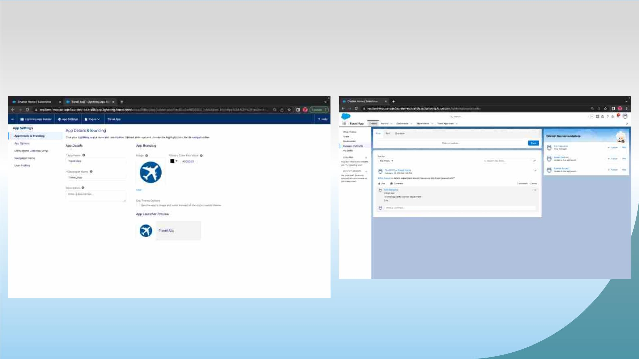
Exercise-01
Creating Lightning App: TRAVEL APP

Slide 7
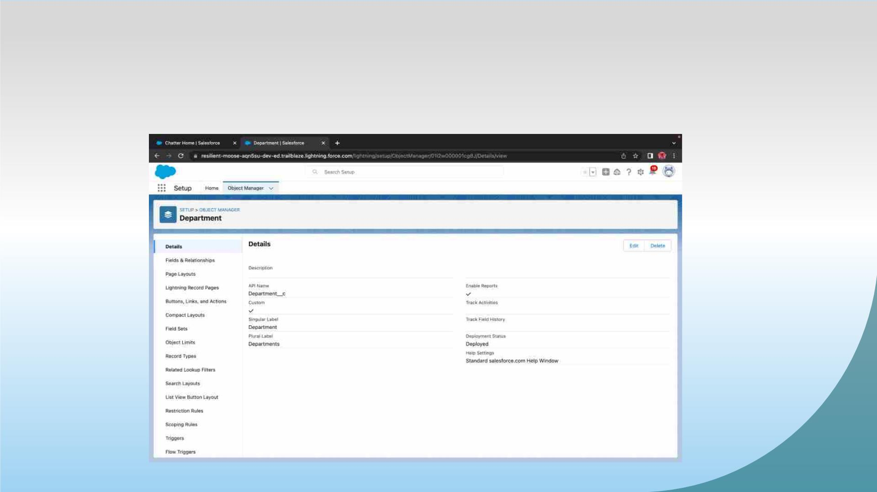
Custom object Department and Creating custom fields
in Department object

Slide 8
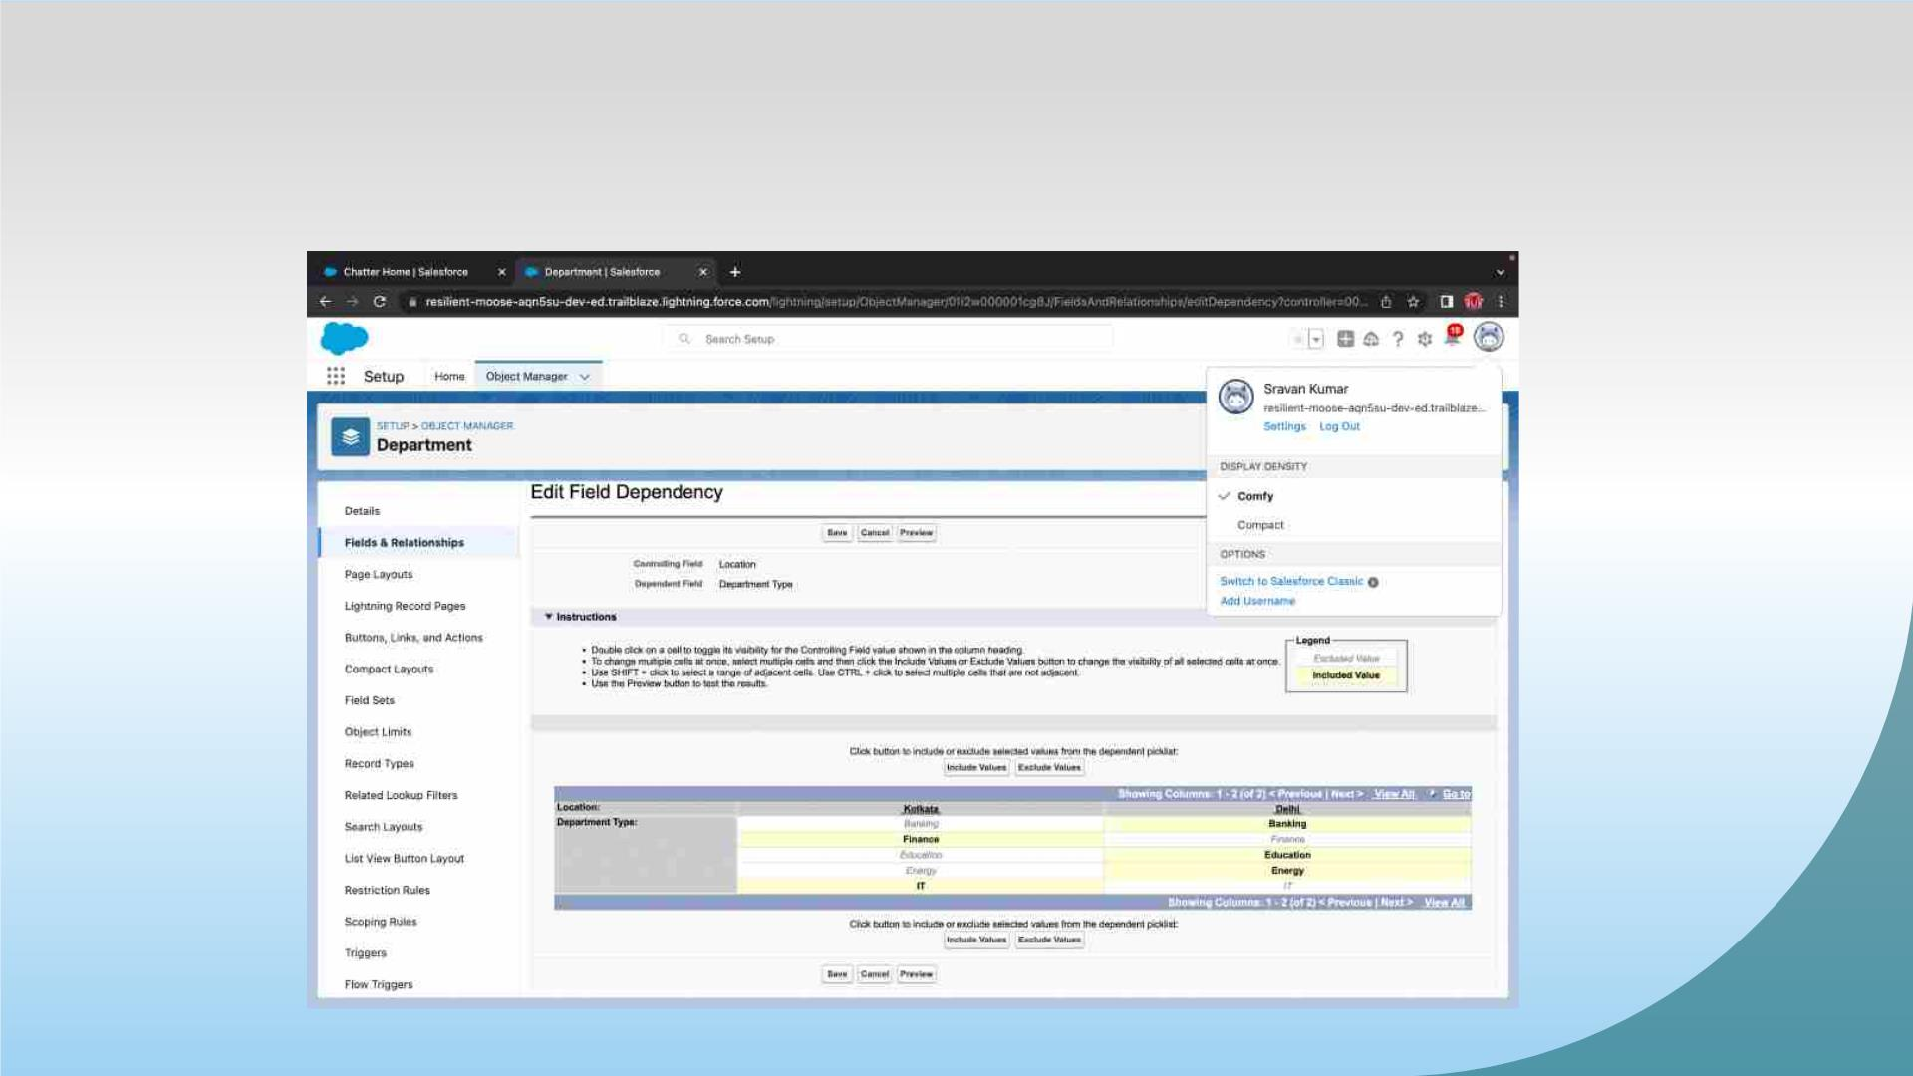
Field dependency in department

Slide 9
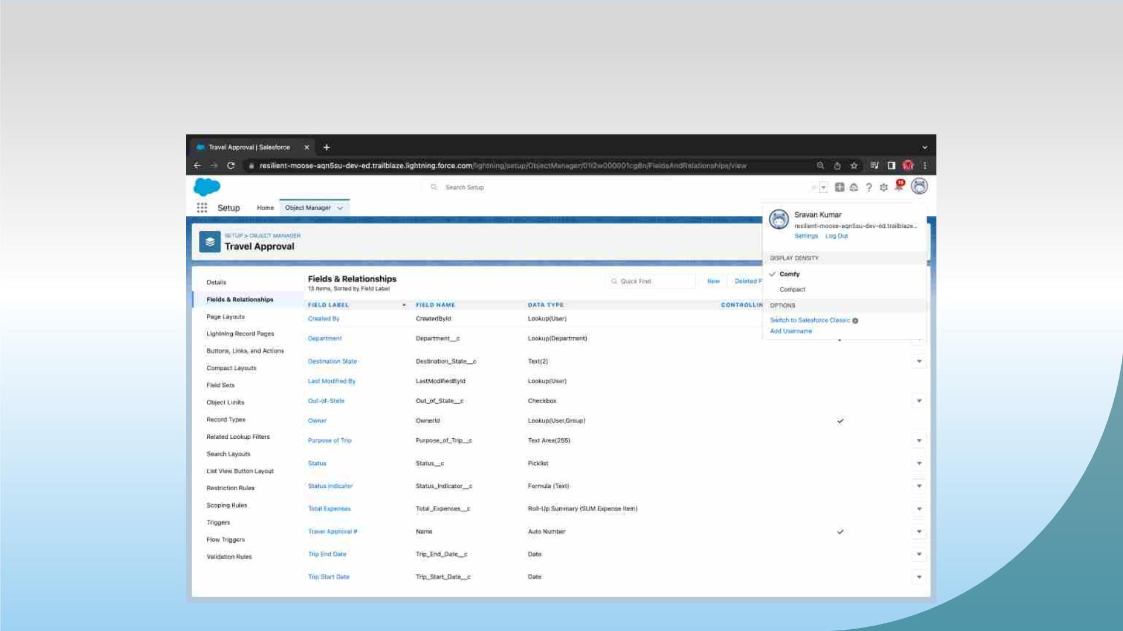
Creating Custom Object Travel Approval and Custom
Fields in that Object

Slide 10
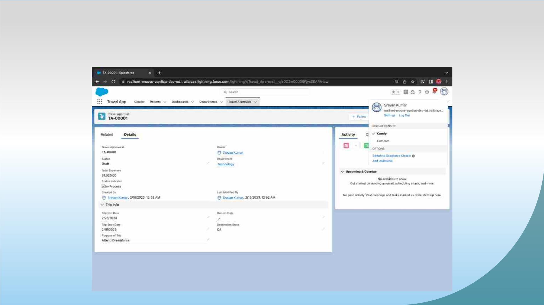
After creating travel approval object with fields, it looks as
shown below

Slide 11
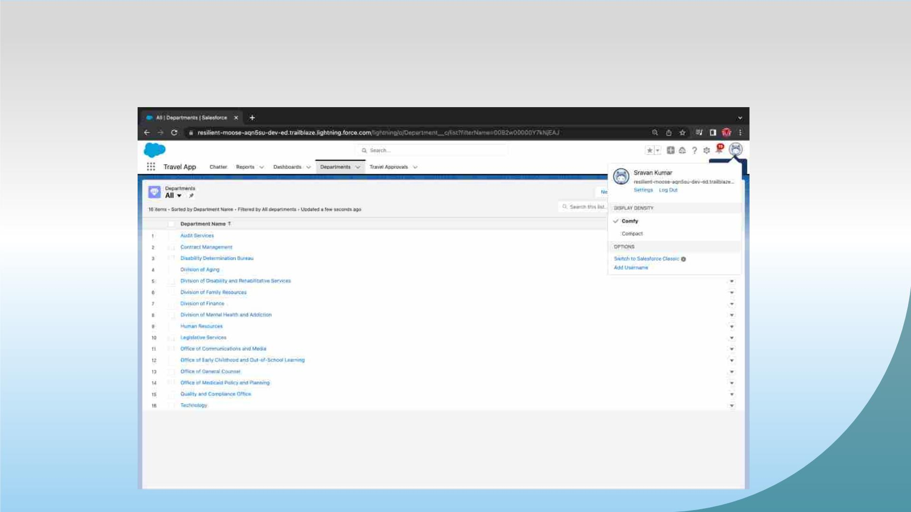
Importing Department records using data import wizard and
imported record data status can viewed below

Slide 12
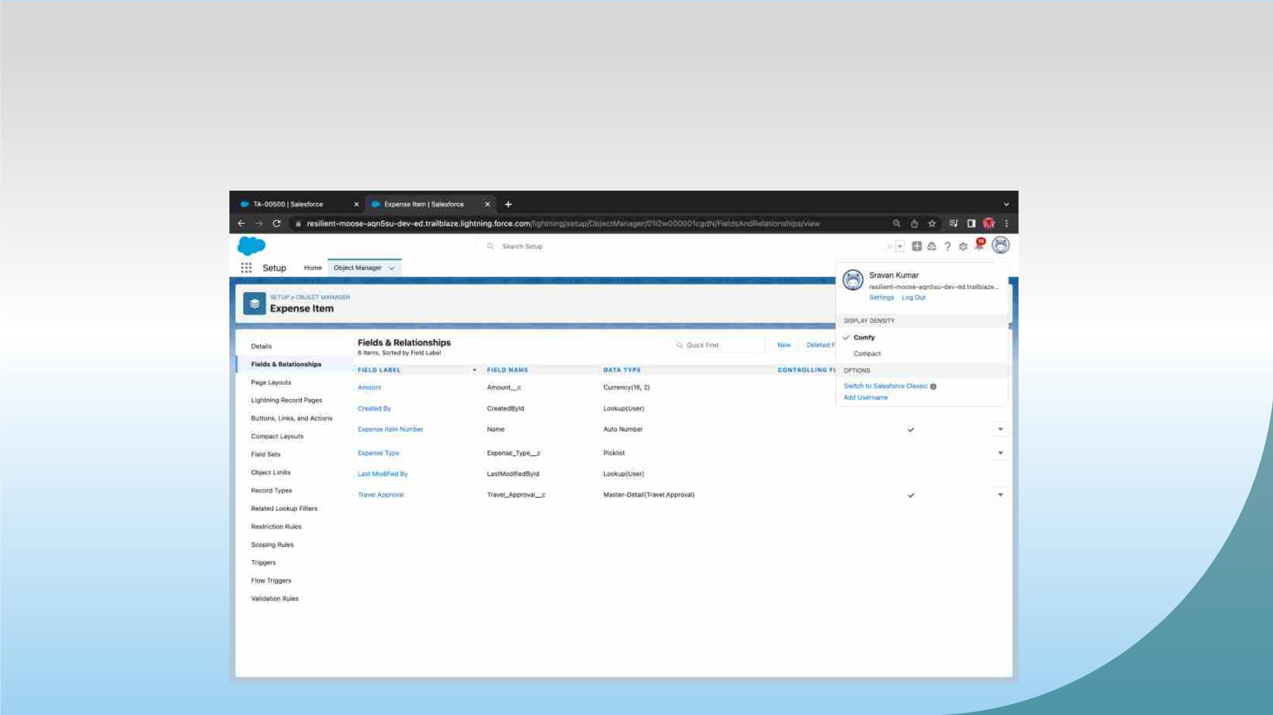
Exercise-02
Creating Expense Item custom object and Custom fields in
Expense Item object

Slide 13
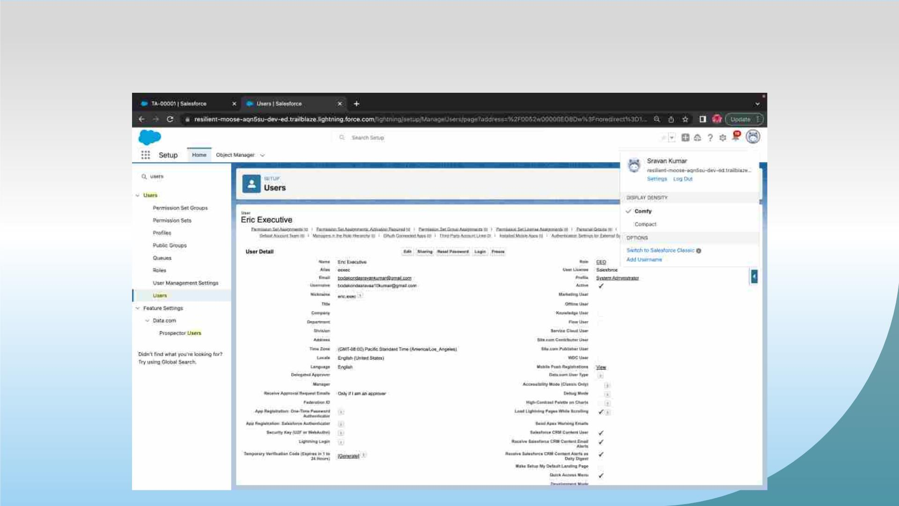
Creating User Eric

Slide 14
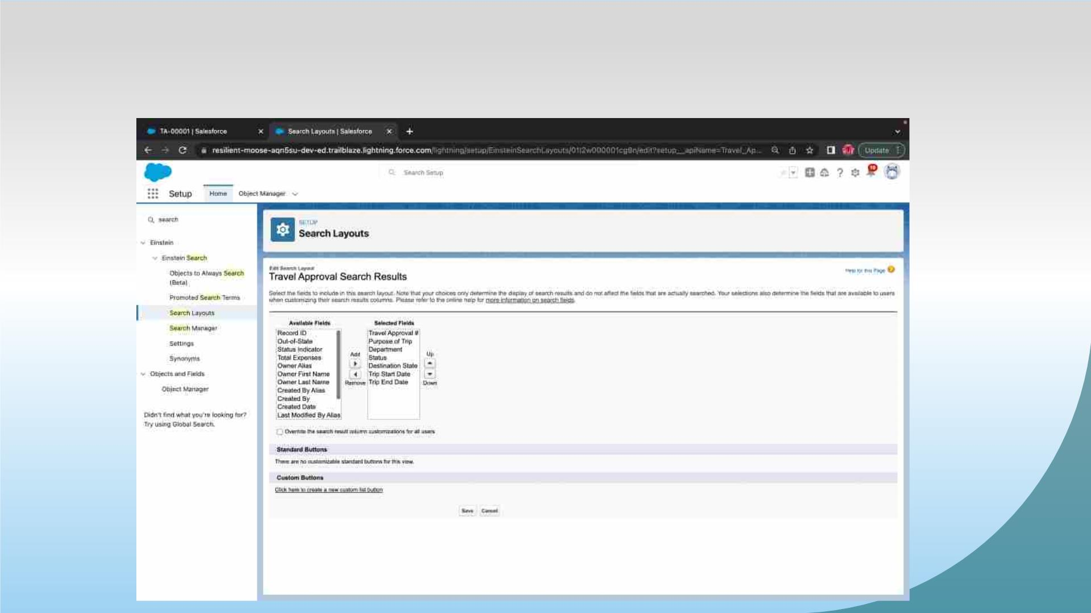
Customize The Travel Approval Default Search Layout

Slide 15
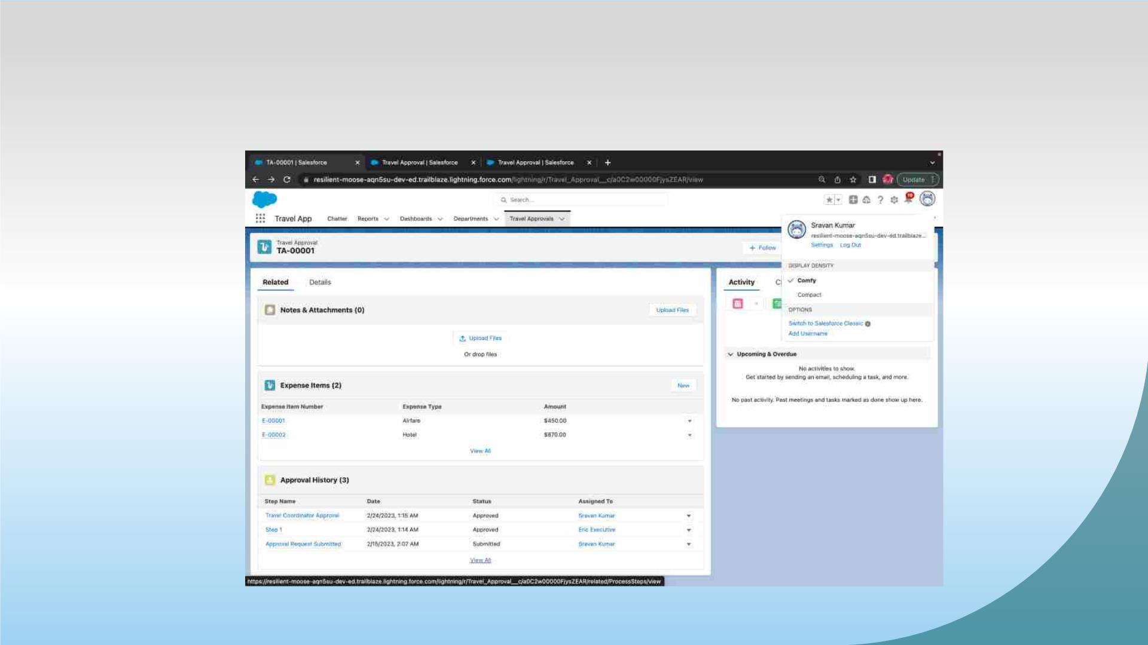
Customizing page layout

Slide 16
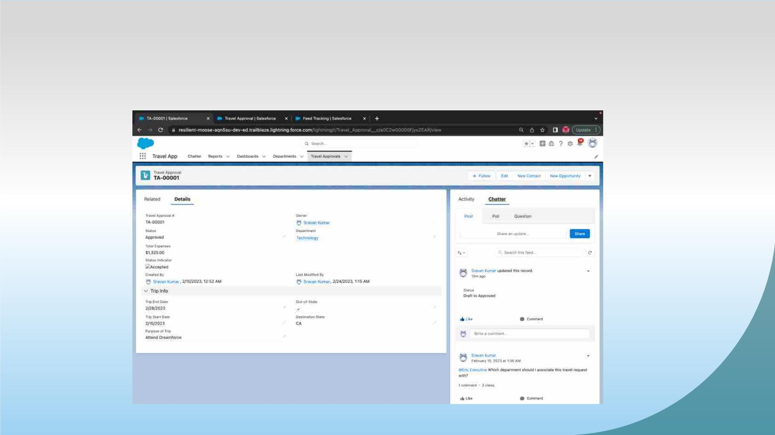
Test the app:

Slide 17

MODULE 2
• This project module focuses on the Automation and Analytics Tools to enhance your custom App
development.
• Define Business logic using Validation rules, Roll-up summary fields, Formulas, Flows & how you
track Travel Approvals using Reports and Dashboards.

Slide 18
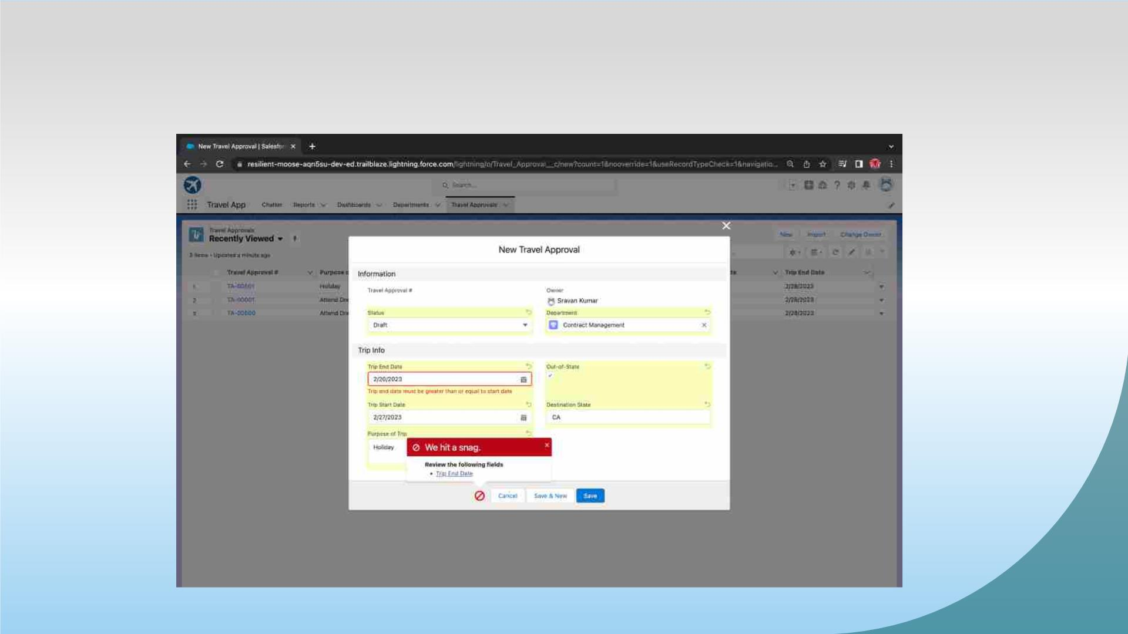
Validation Rule that trip end date always >= start date

Slide 19
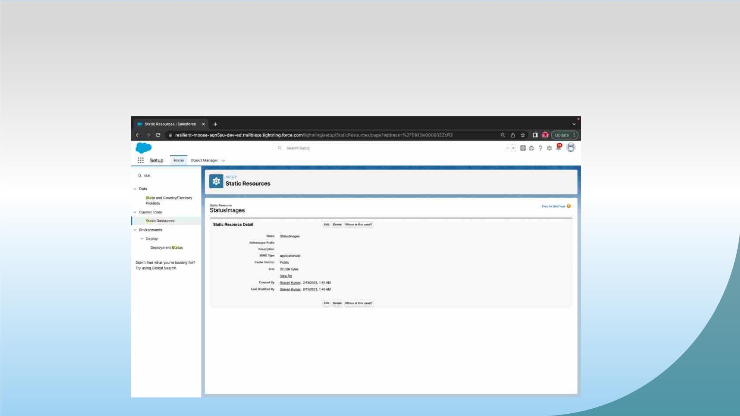
Creating Formula Fields Static Resource with name
StatusImages

Slide 20
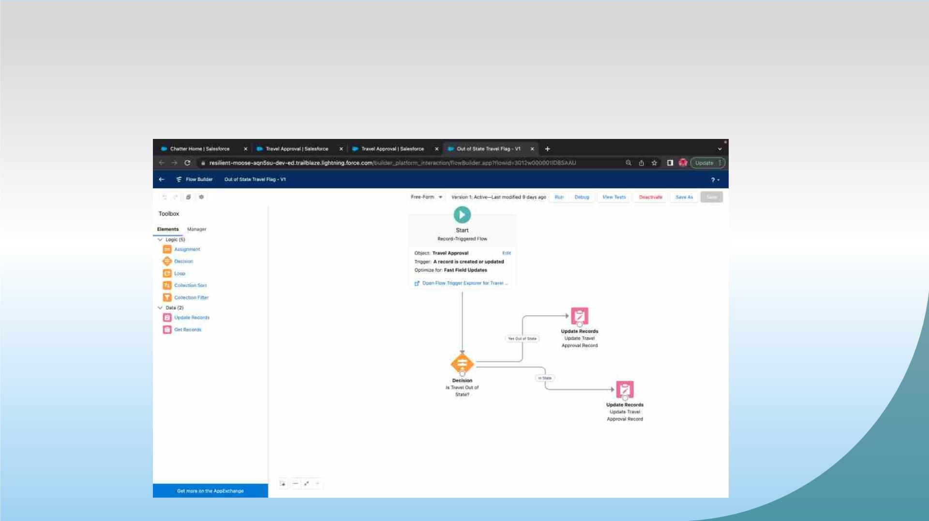
Create a flow looks as shown, save and activate

Slide 21
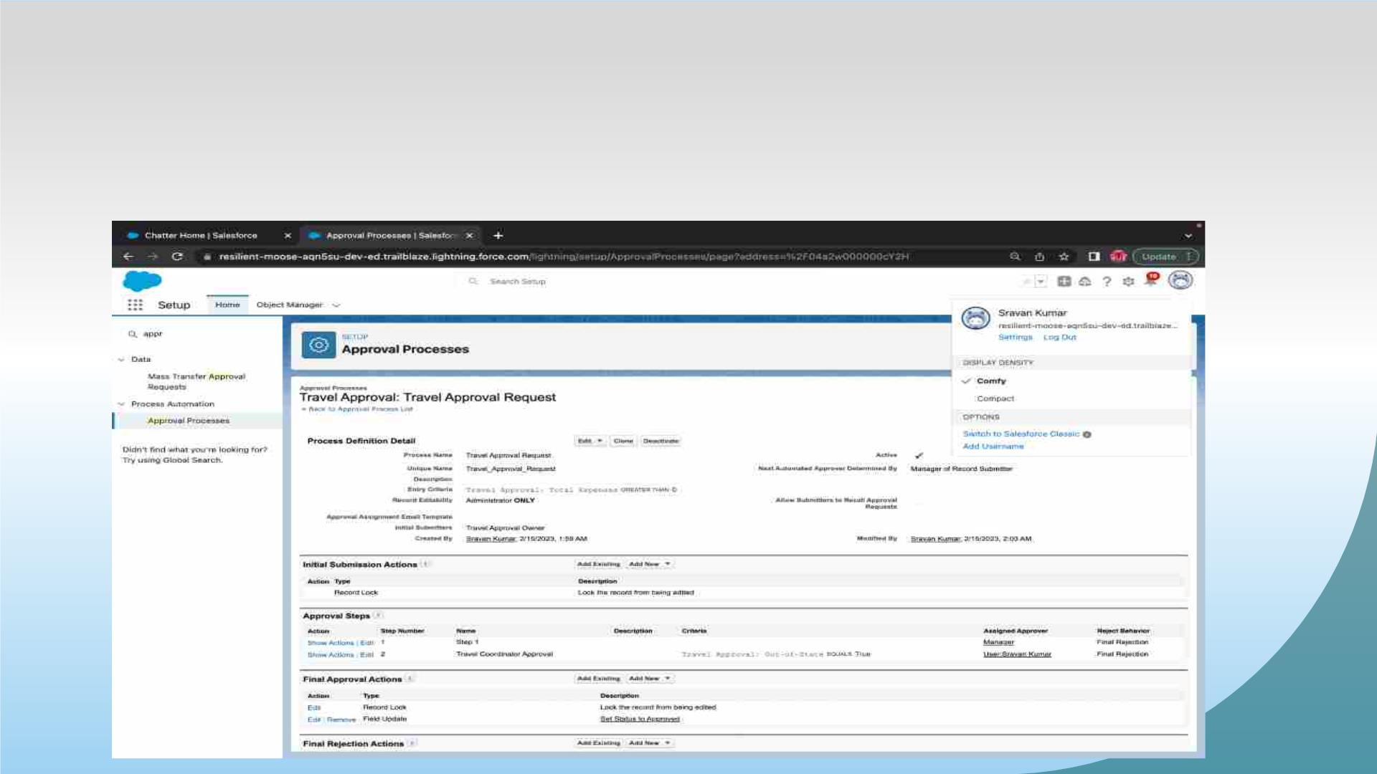
Creating an Approval Process to send travel approvals to
manager or travel coordinator

Slide 22
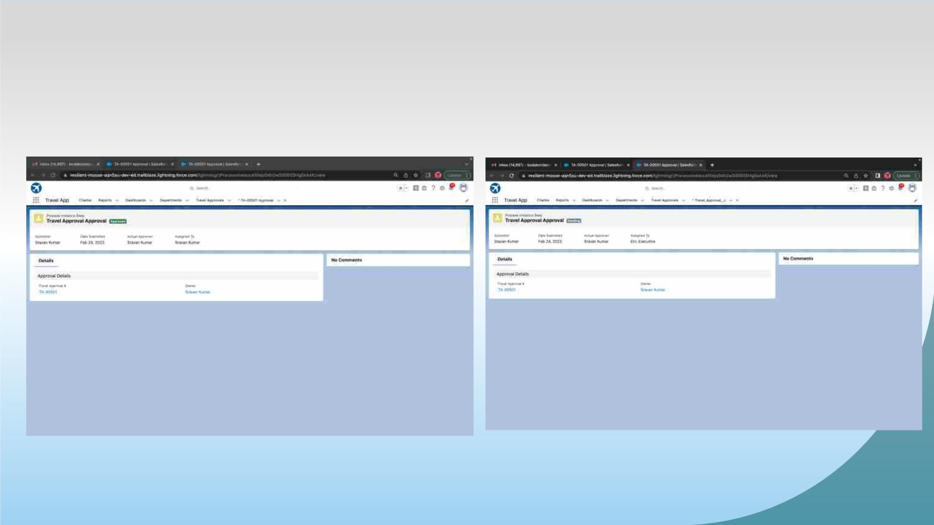
Testing the Approval Process Status is Pending Here,
Next Submit For Approval

Slide 23
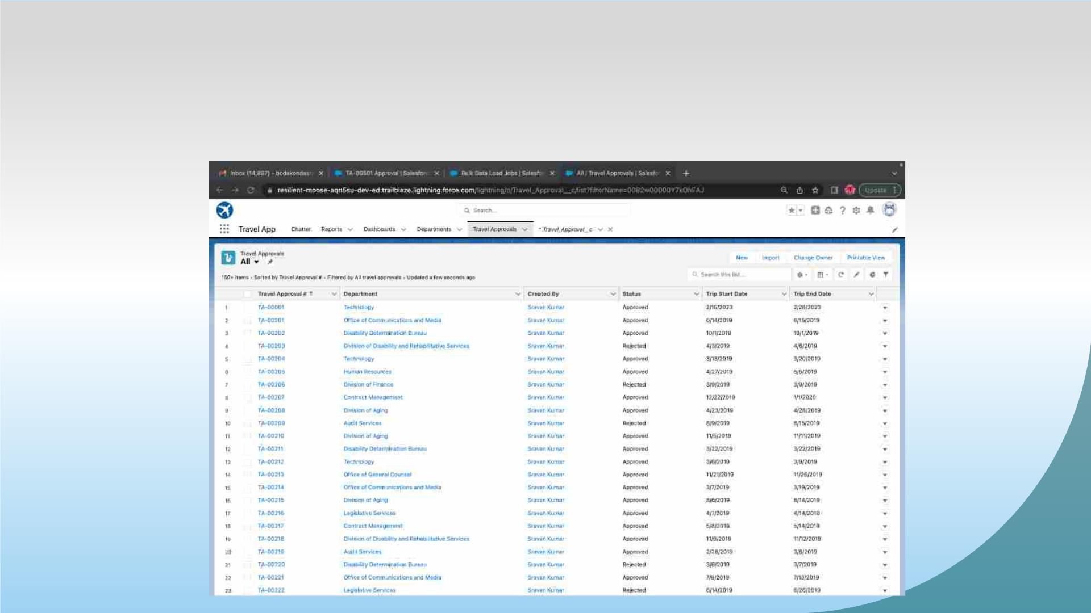
Using Data import wizard to import travel approval records ,
later the Records imported successfully

Slide 24
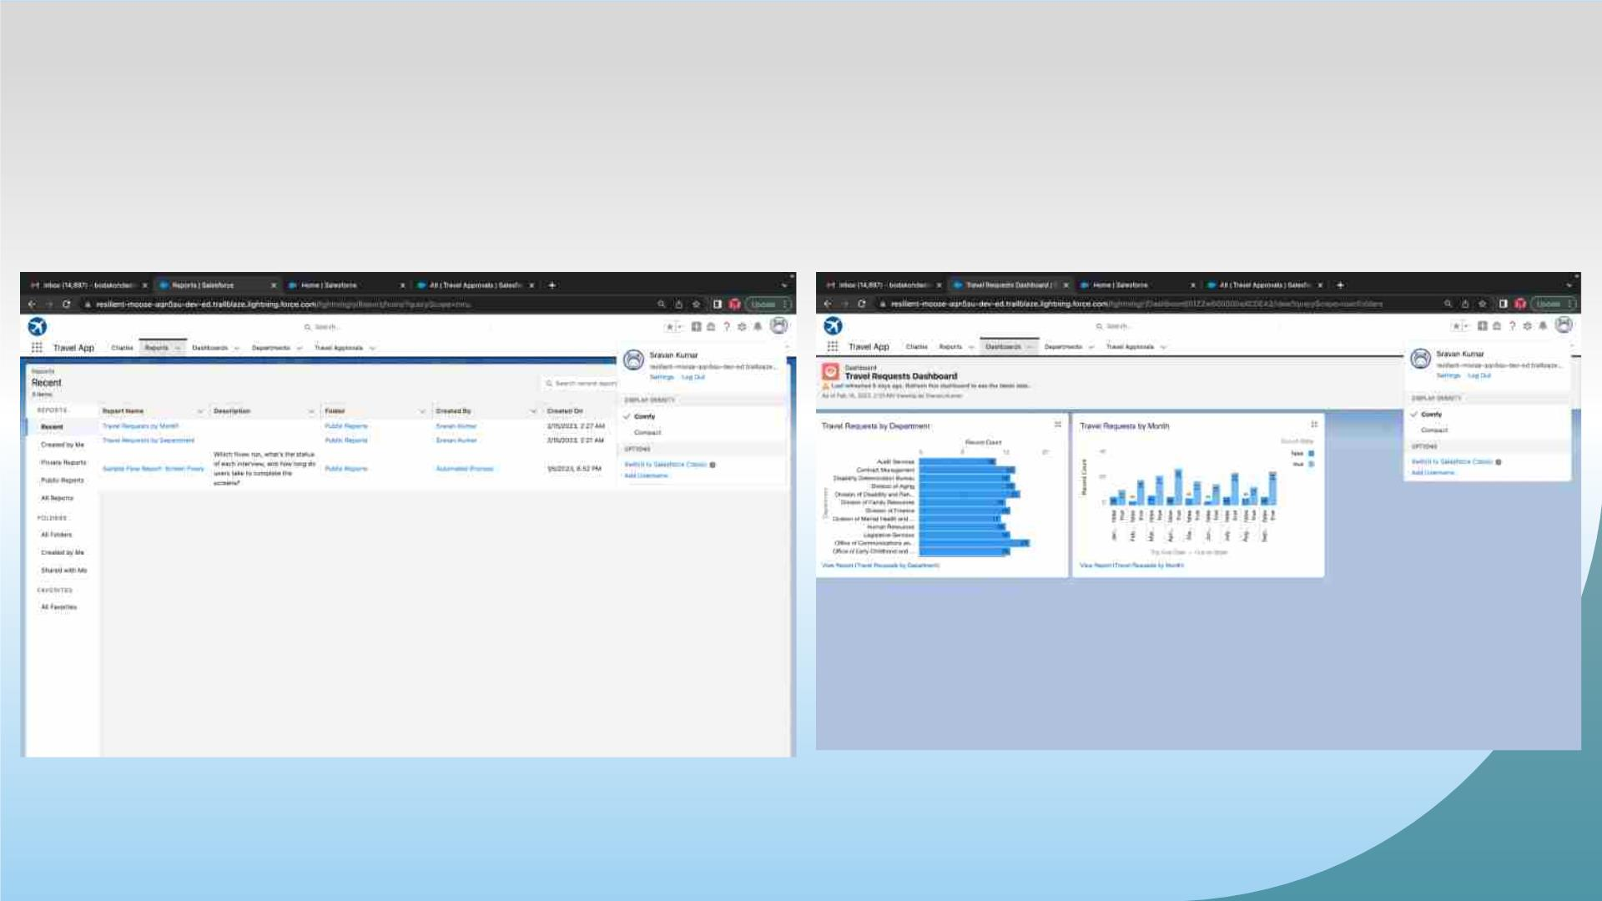
Created Reports and Dashboard

Slide 25

MODULE 3
• This project module focuses on the coding approach to extend the functional
capabilities of your custom App.

Slide 26
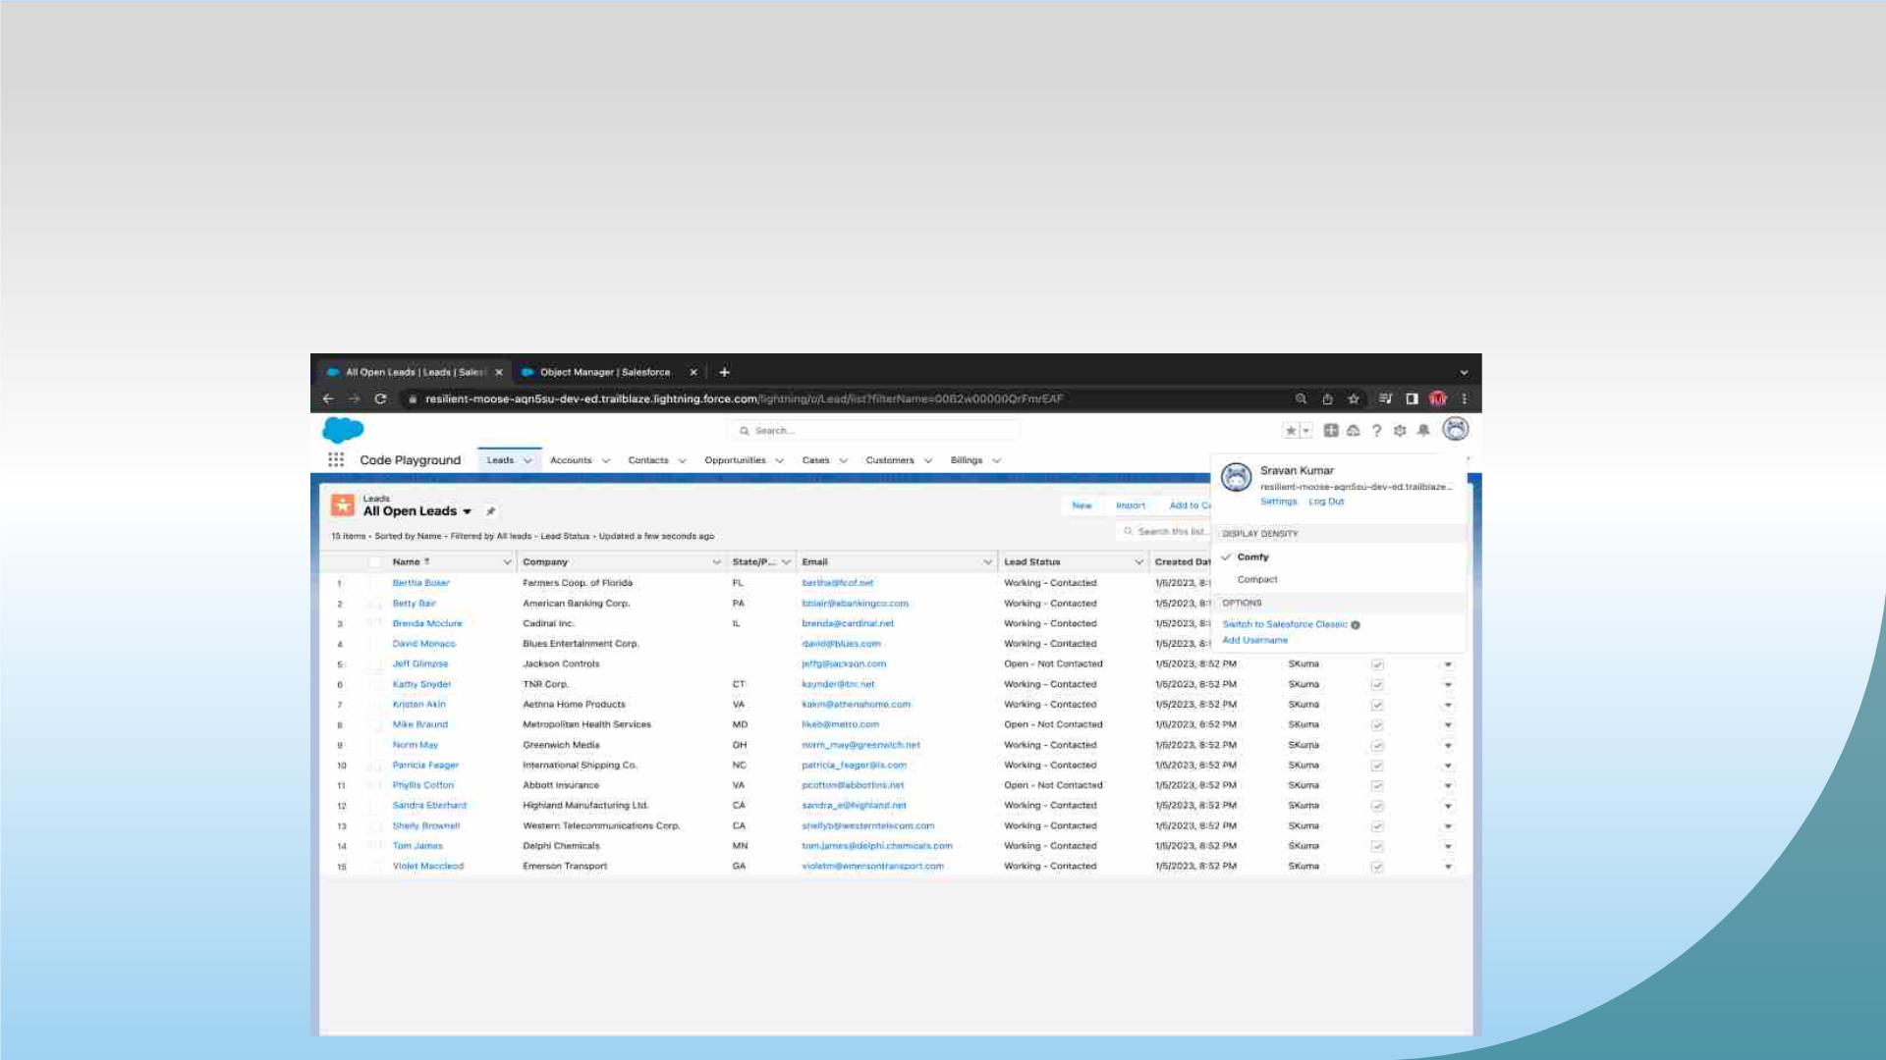
Exercise - 01
Creating Code Playground Lightning App with Lead,
Account, Contact, Opportunity, Case to navigation
profile as system admin.

Slide 27
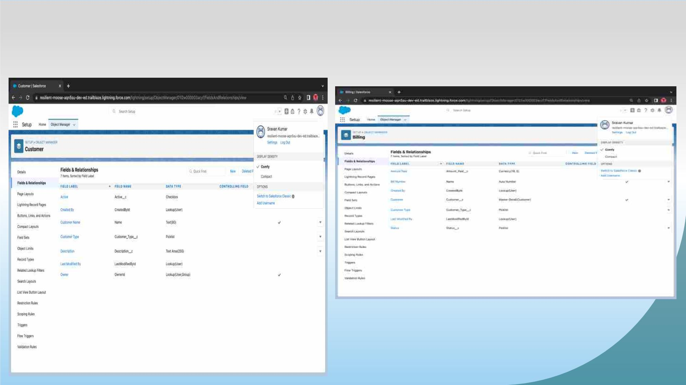
Creating custom objects Customer , Billing and add related
fields

Slide 28
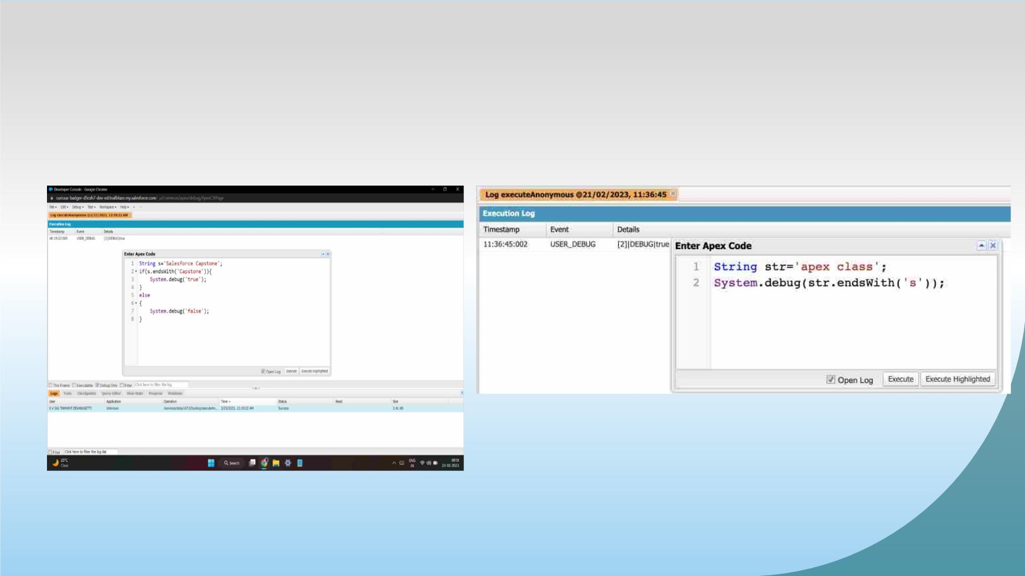
Exercise - 02
Define a String Variable & use string method ‘endsWith’
to display the output.

Slide 29
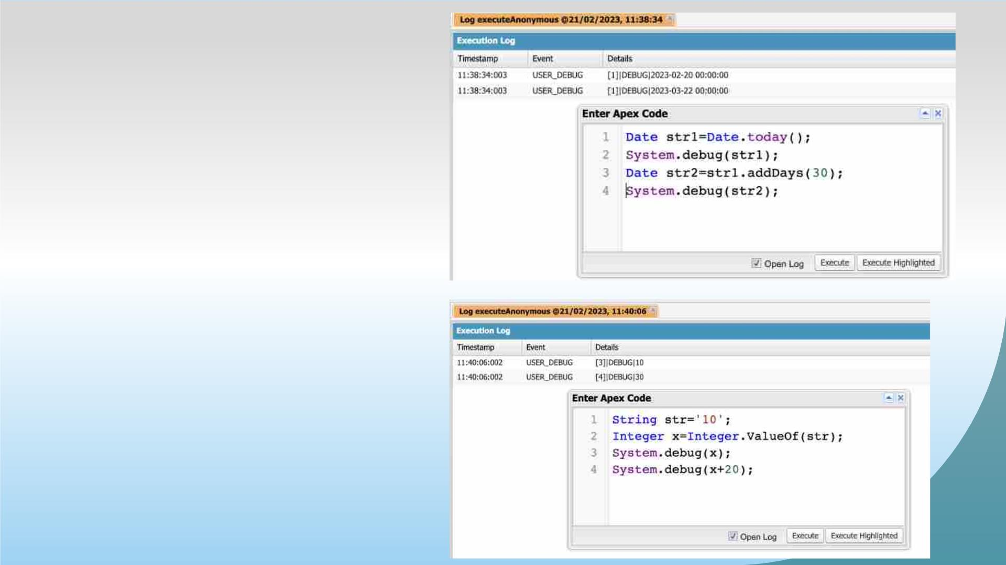
2. Define 2 Date type variables, use
Date method today() & addDays(30) to
display the output
3. Display the Output of an integer
variable from string ‘10’ and then
add 20 to it.

Slide 30
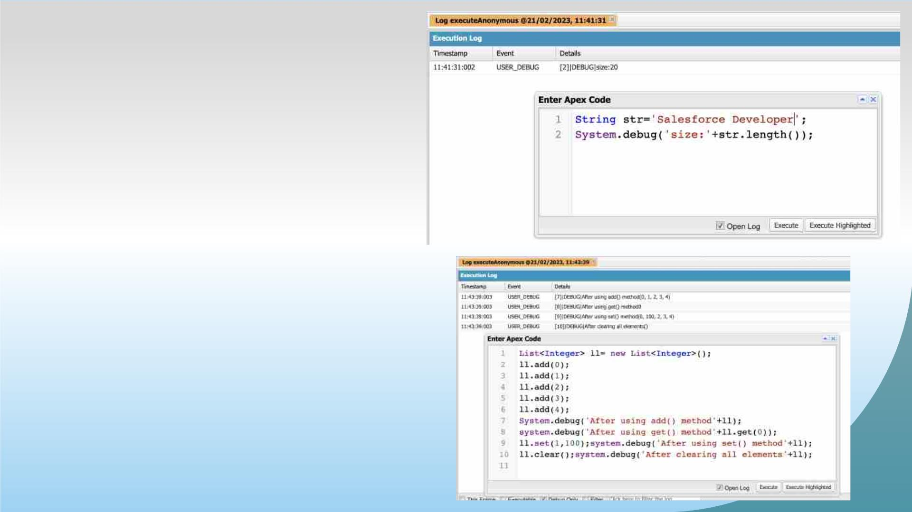
4.Define a string variable & Use String
method length() to Display the output
5.Define a list of integer and
display the output using add(),
get(), set() , clear() , Methods

Slide 31
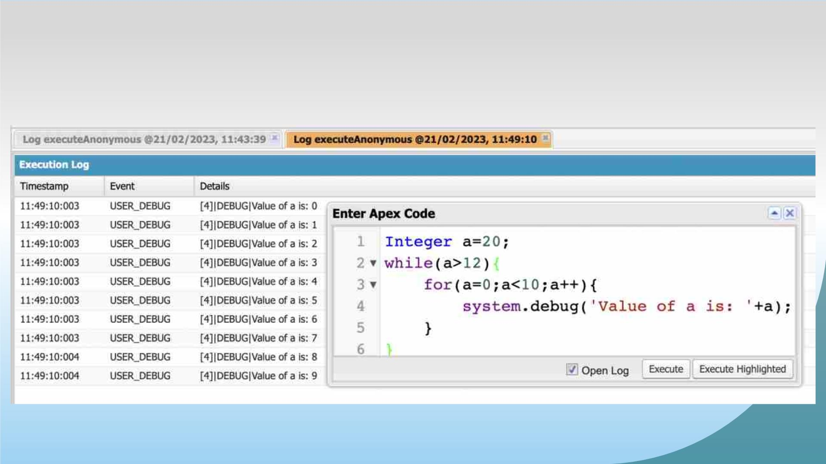
Use Execute Anonymous to define and execute the following
code to display the value of x = 0 to 9.

Slide 32
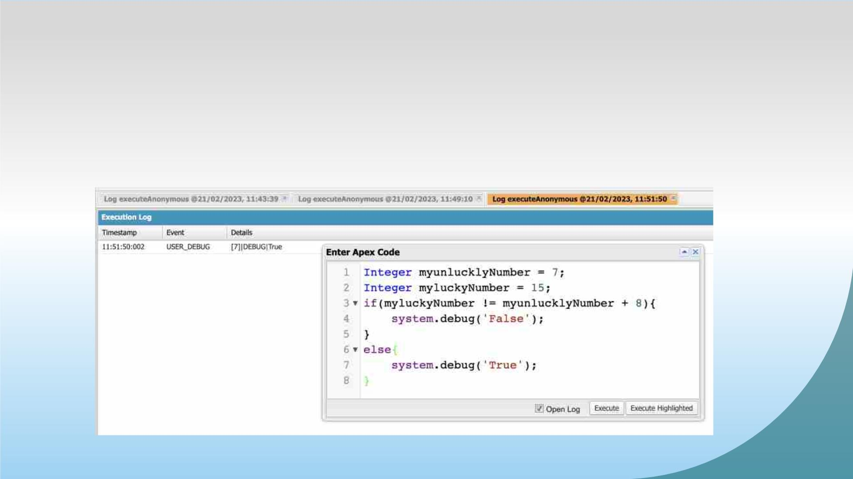
Exercise -03
Answer the following in True or False:
Integer myunlucklyNumber = 7; Integer myluckyNumber =
15;
myluckyNumber != myunlucklyNumber + 8.

Slide 33
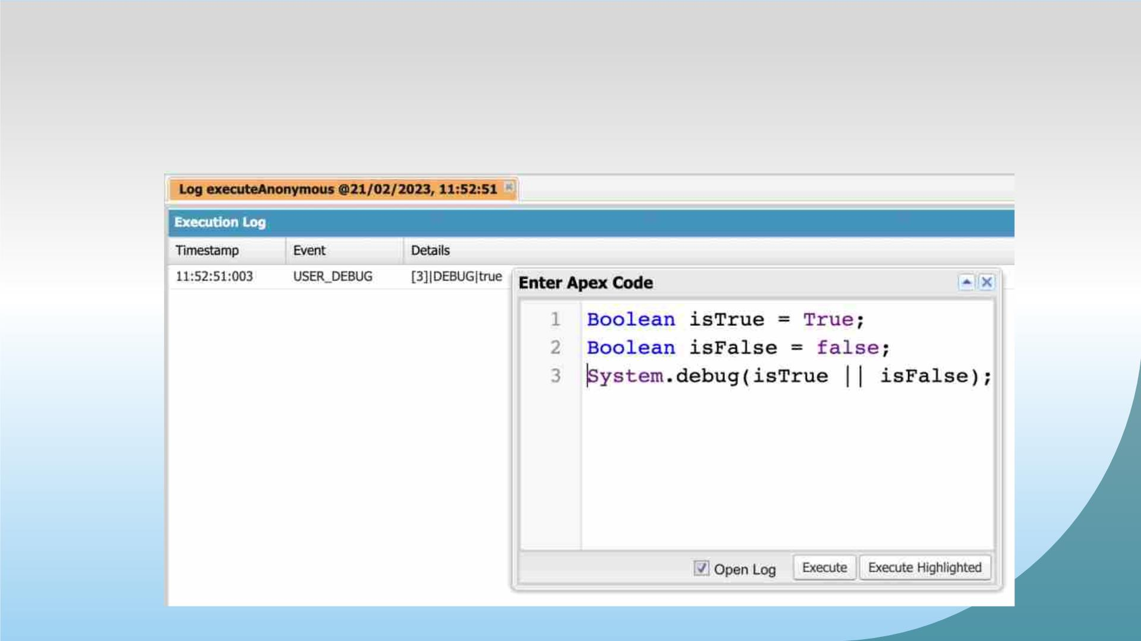
Exercise-04
Answer the following in True Or False:
Boolean isFalse = false; Boolean isTrue = true;

Slide 34
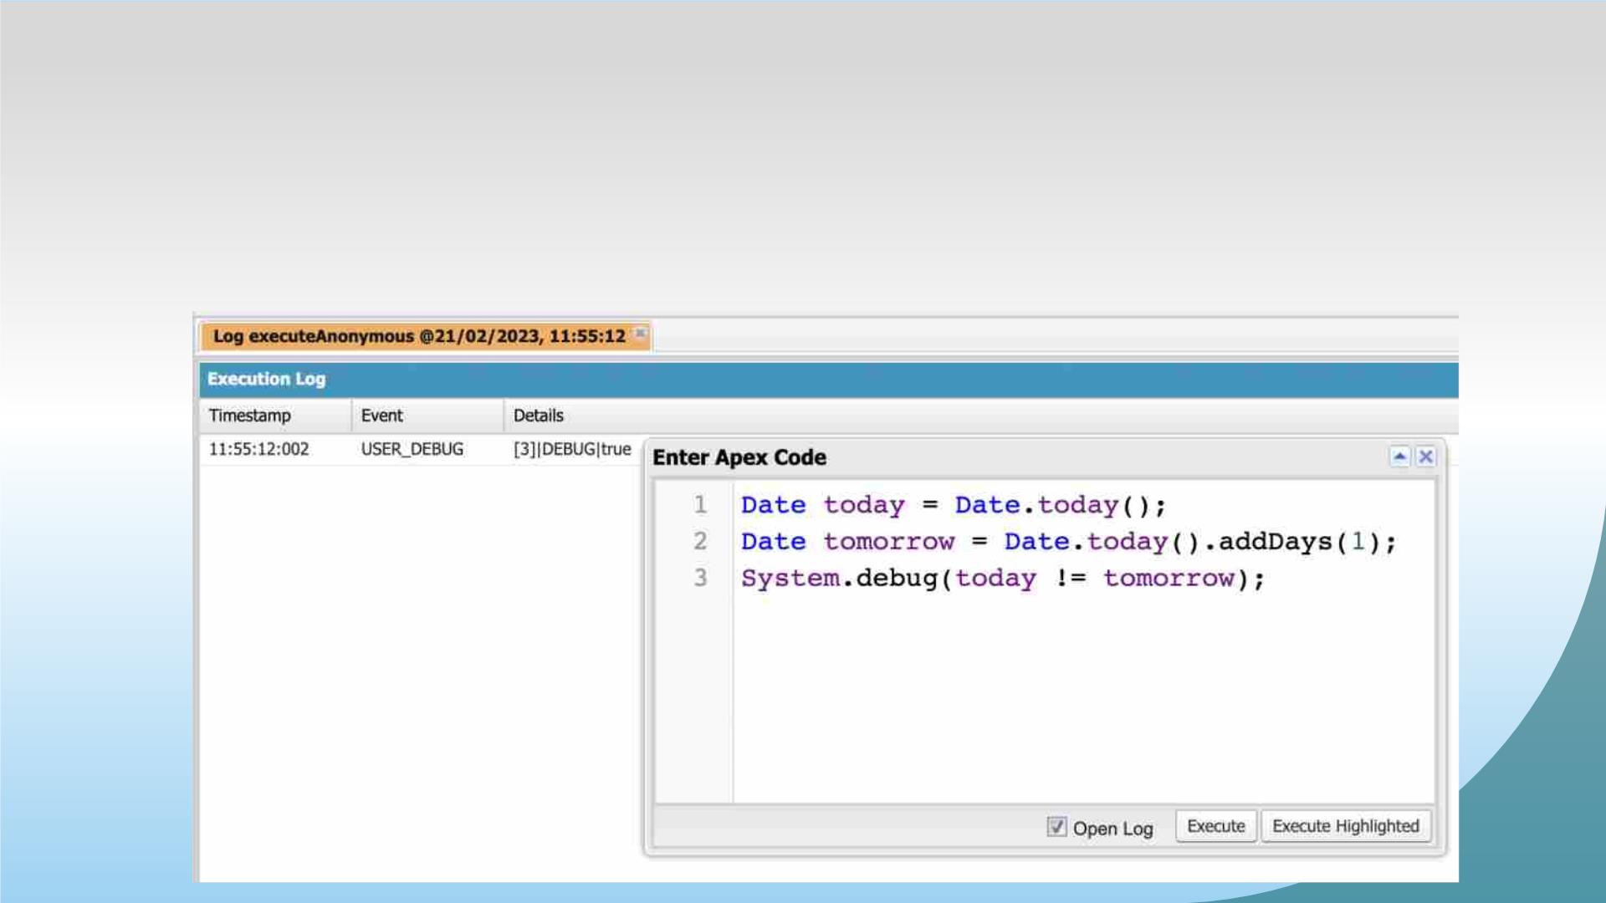
Exercise -05
Answer the following in True Or False:
Date tomorrow = Date.today().addDays(1); Date today =
Date.today();
today != tomorrow

Slide 35
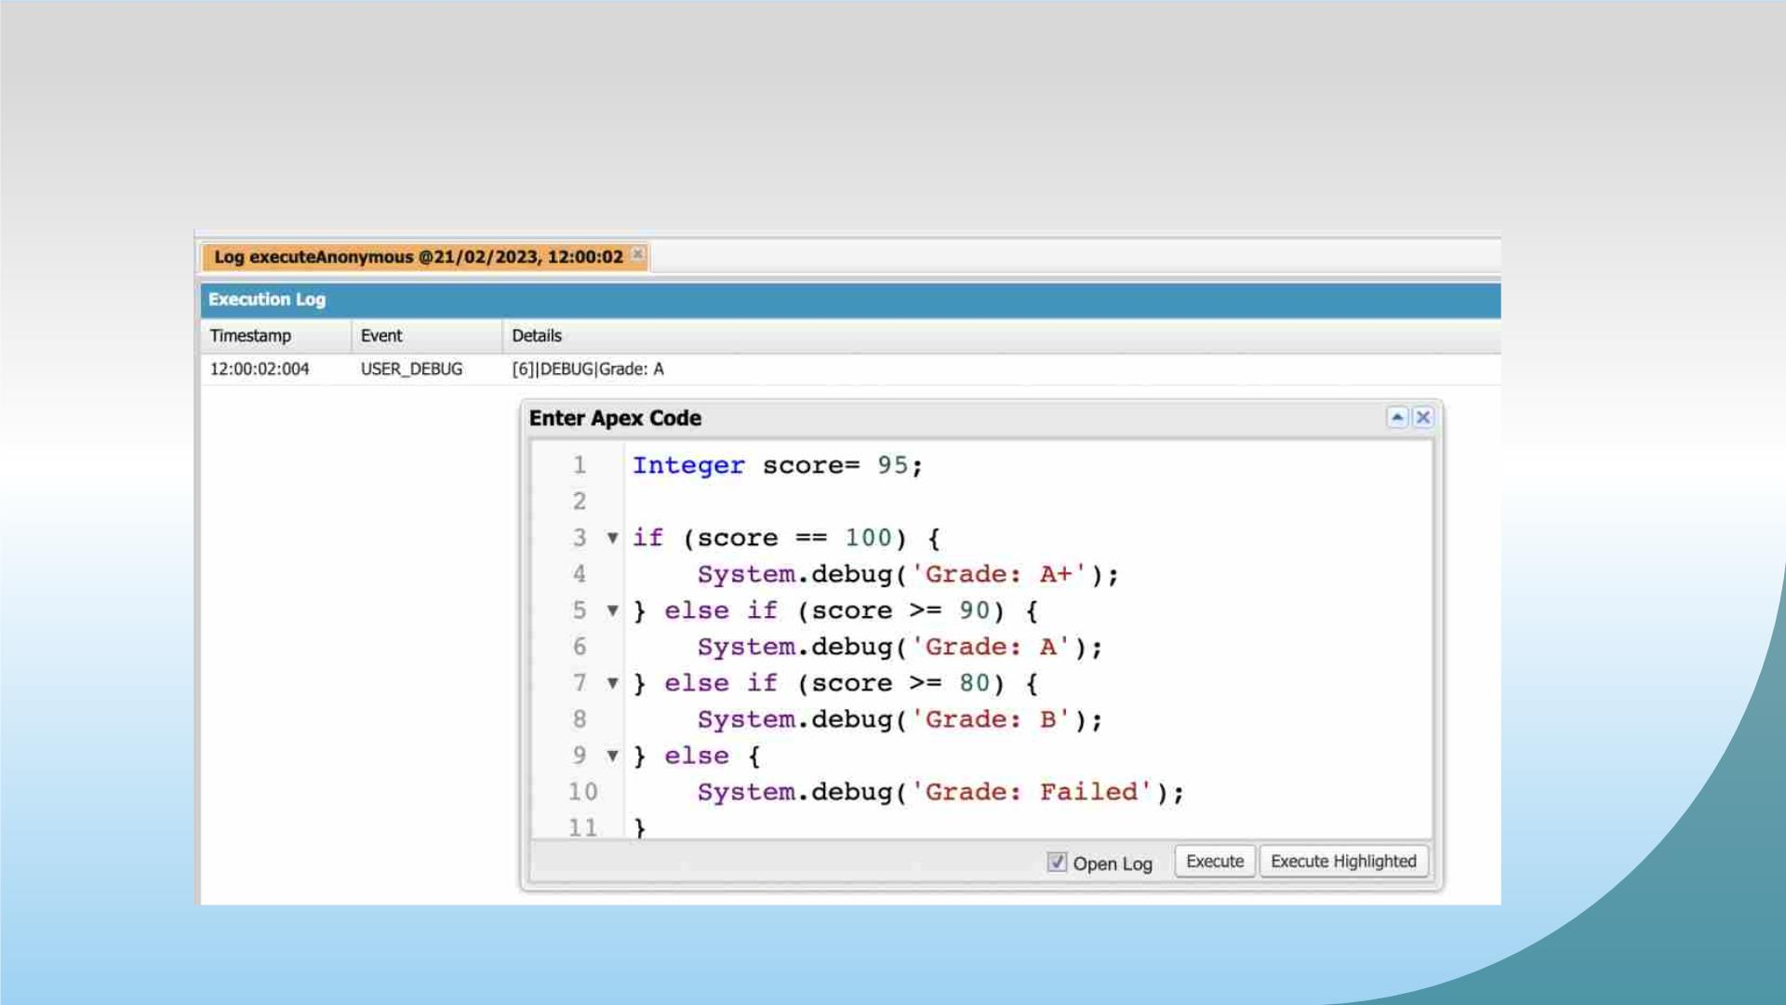
Exercise-06
Write a program and execute to demo the use of “If..else if...else”

Slide 36
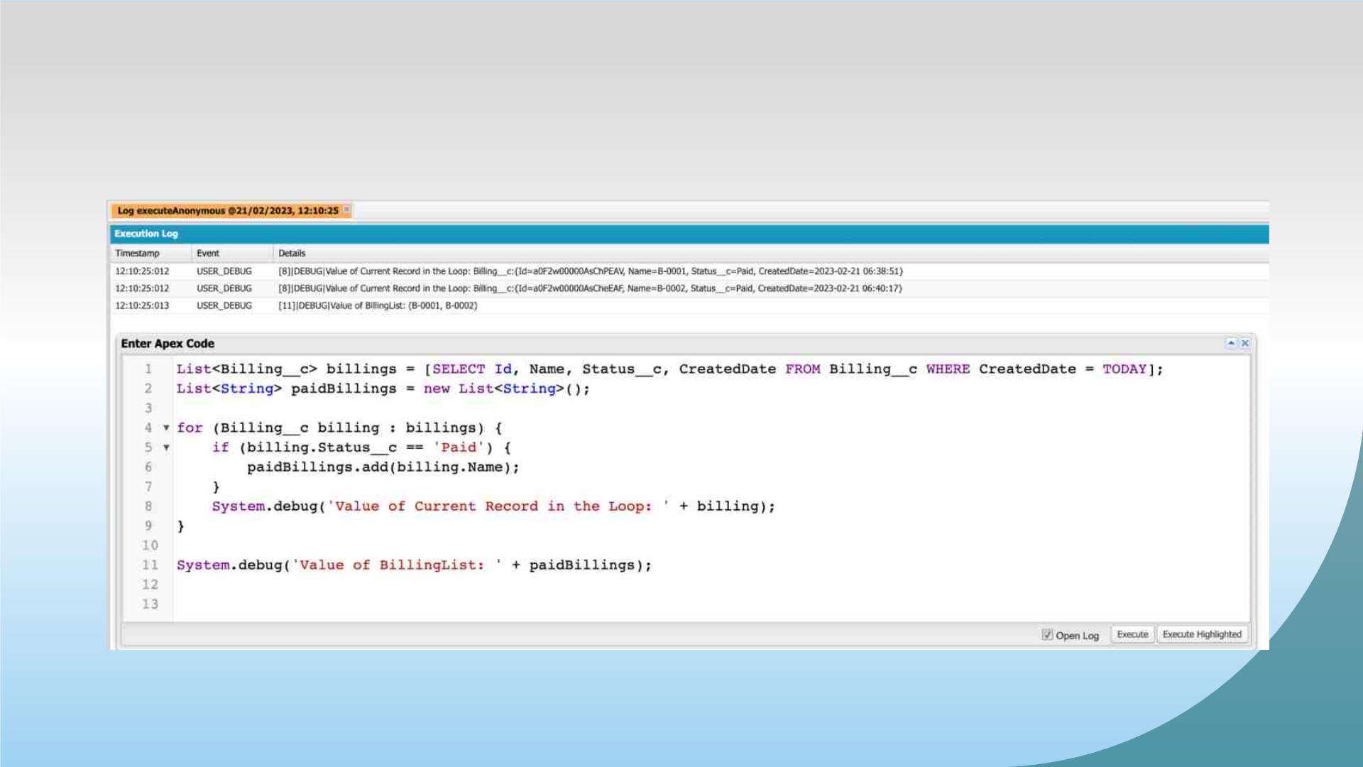
Exercise-07
Write a program to execute and demo the use of “Apex – for Loop”

Slide 37
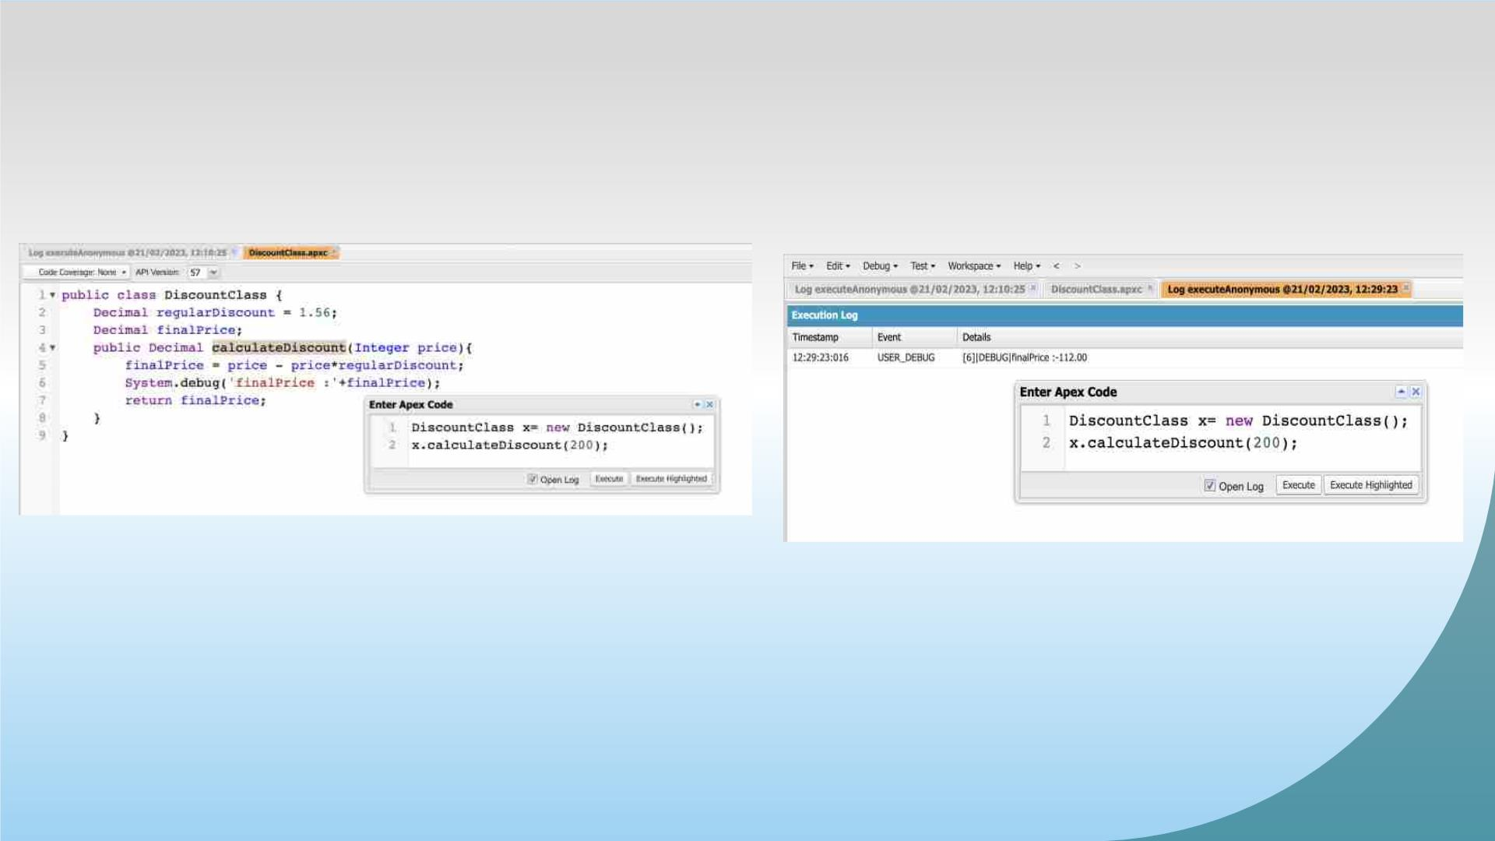
Exercise-08
Write a Class to demo the use of Constants in Apex

Slide 38
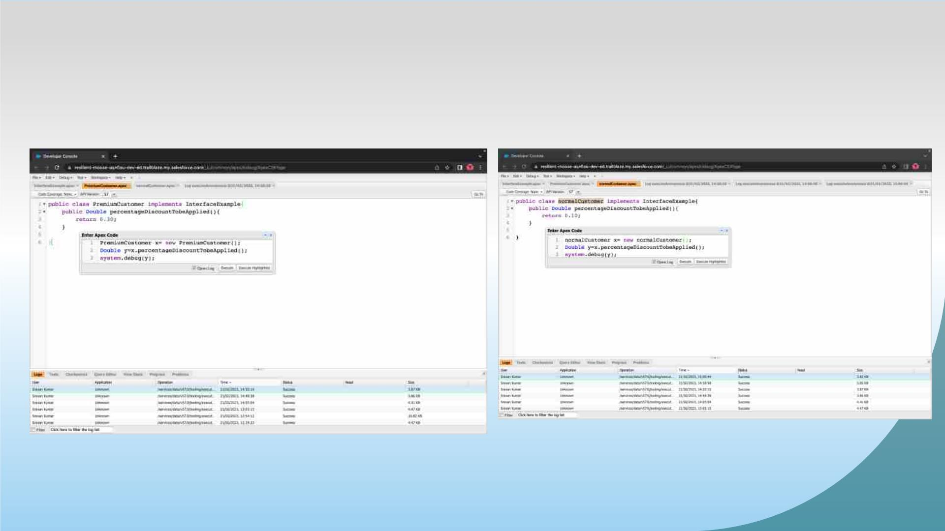
Exercise-09
Write a Class to demo the use of Interface in Apex

Slide 39
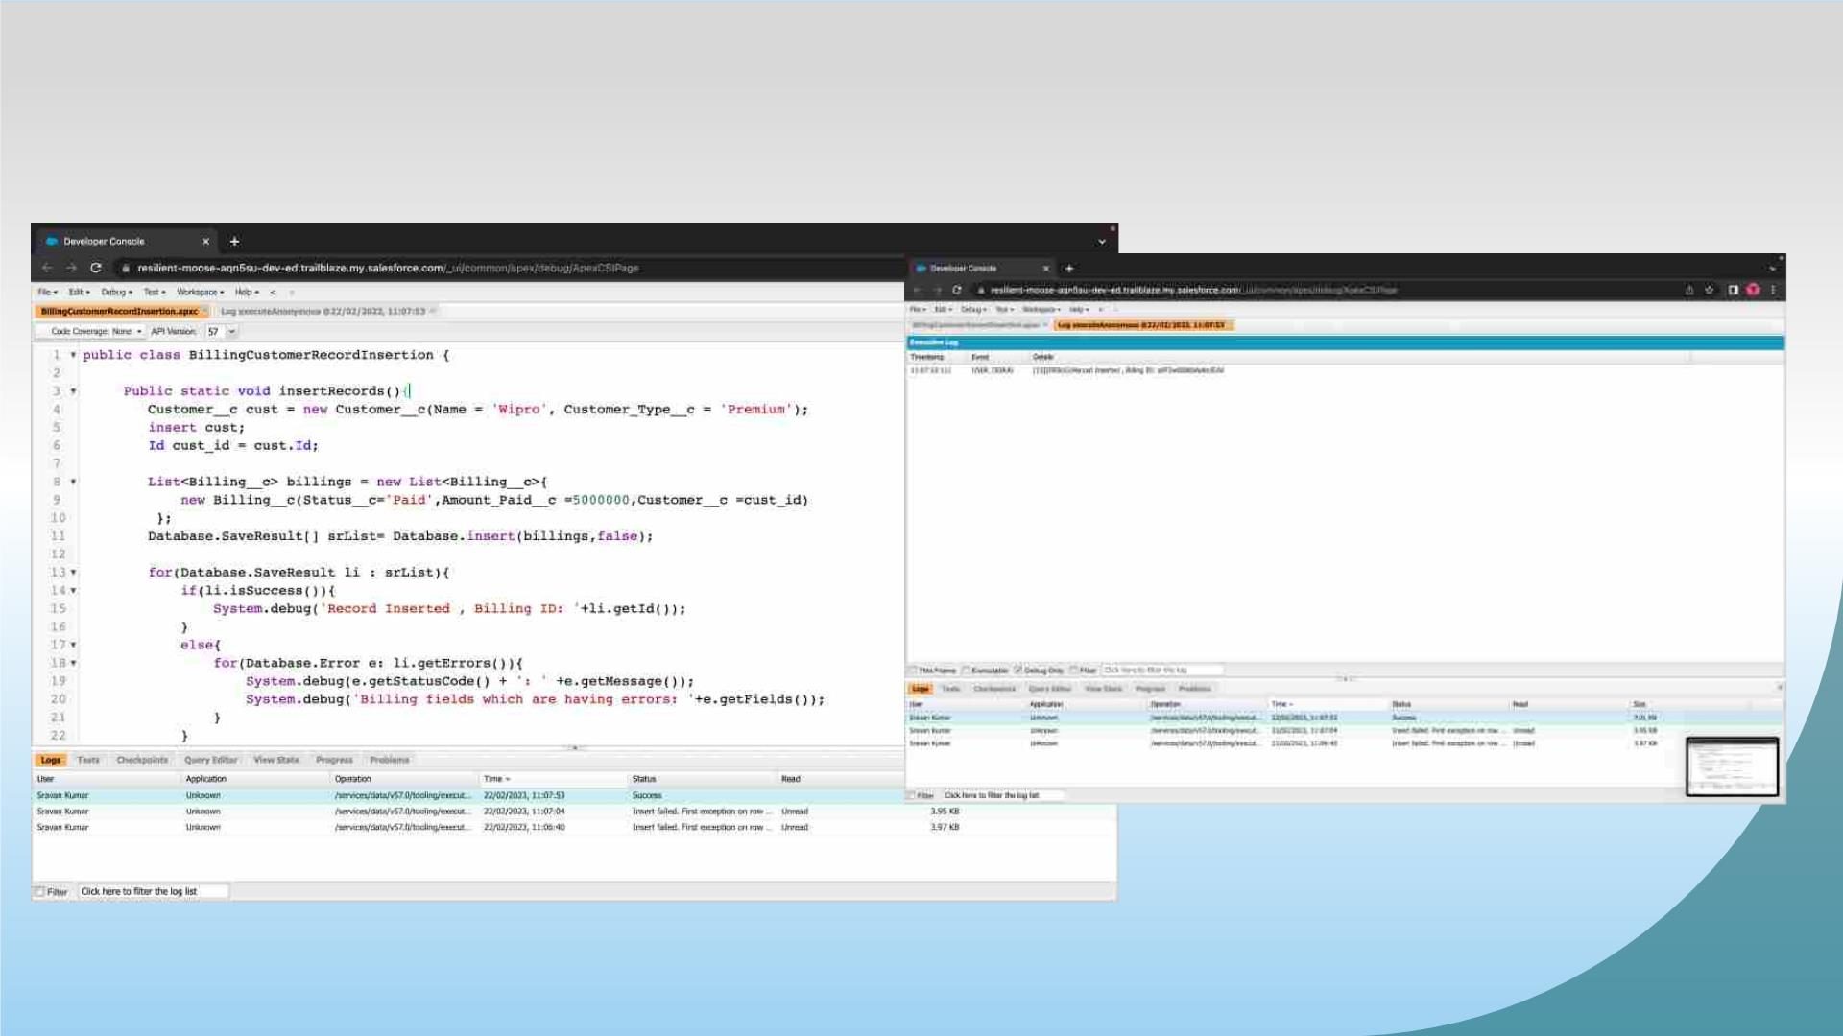
Exercise-10
Demo on DML Insert Operation Using Database methods
Insert a Customer Record First using simple DML Statement

Slide 40
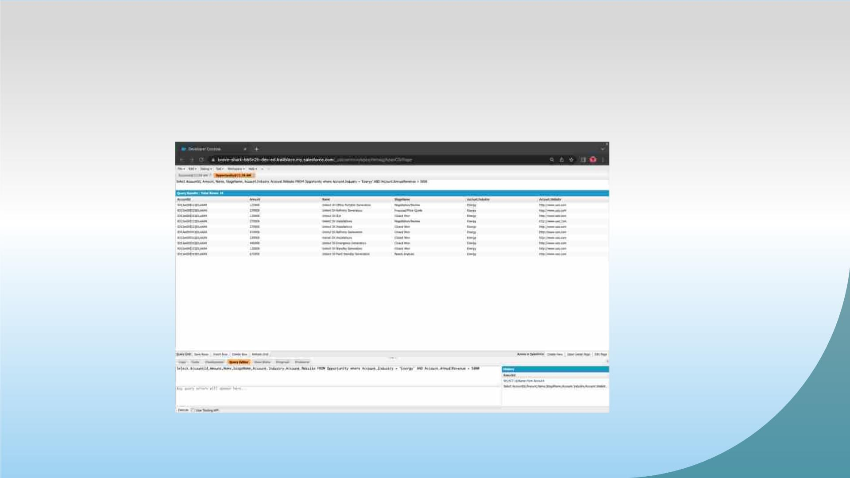
Exercise-11
Write and execute SOQL queries from Developer Console

Slide 41
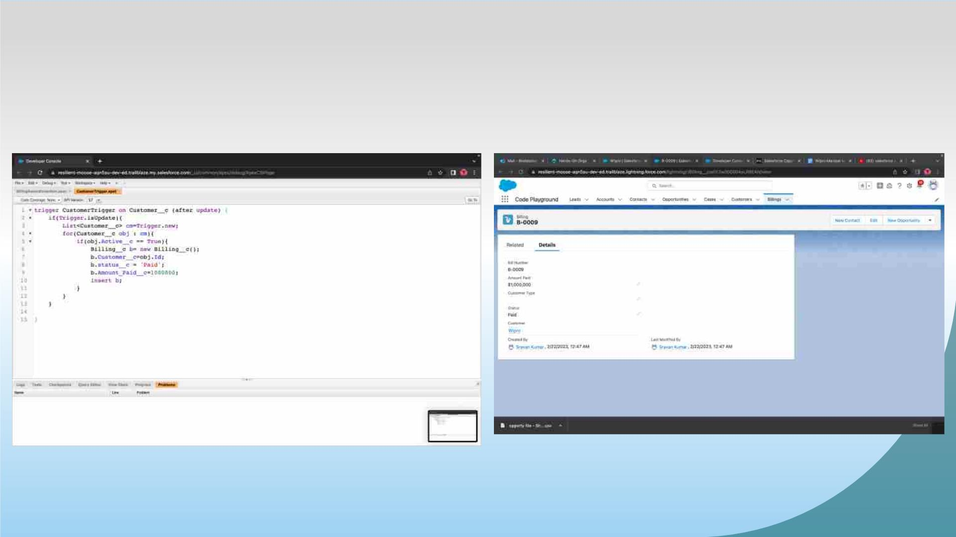
Exercise-12
Write an Apex Trigger, Name = CustomerTrigger.

Slide 42
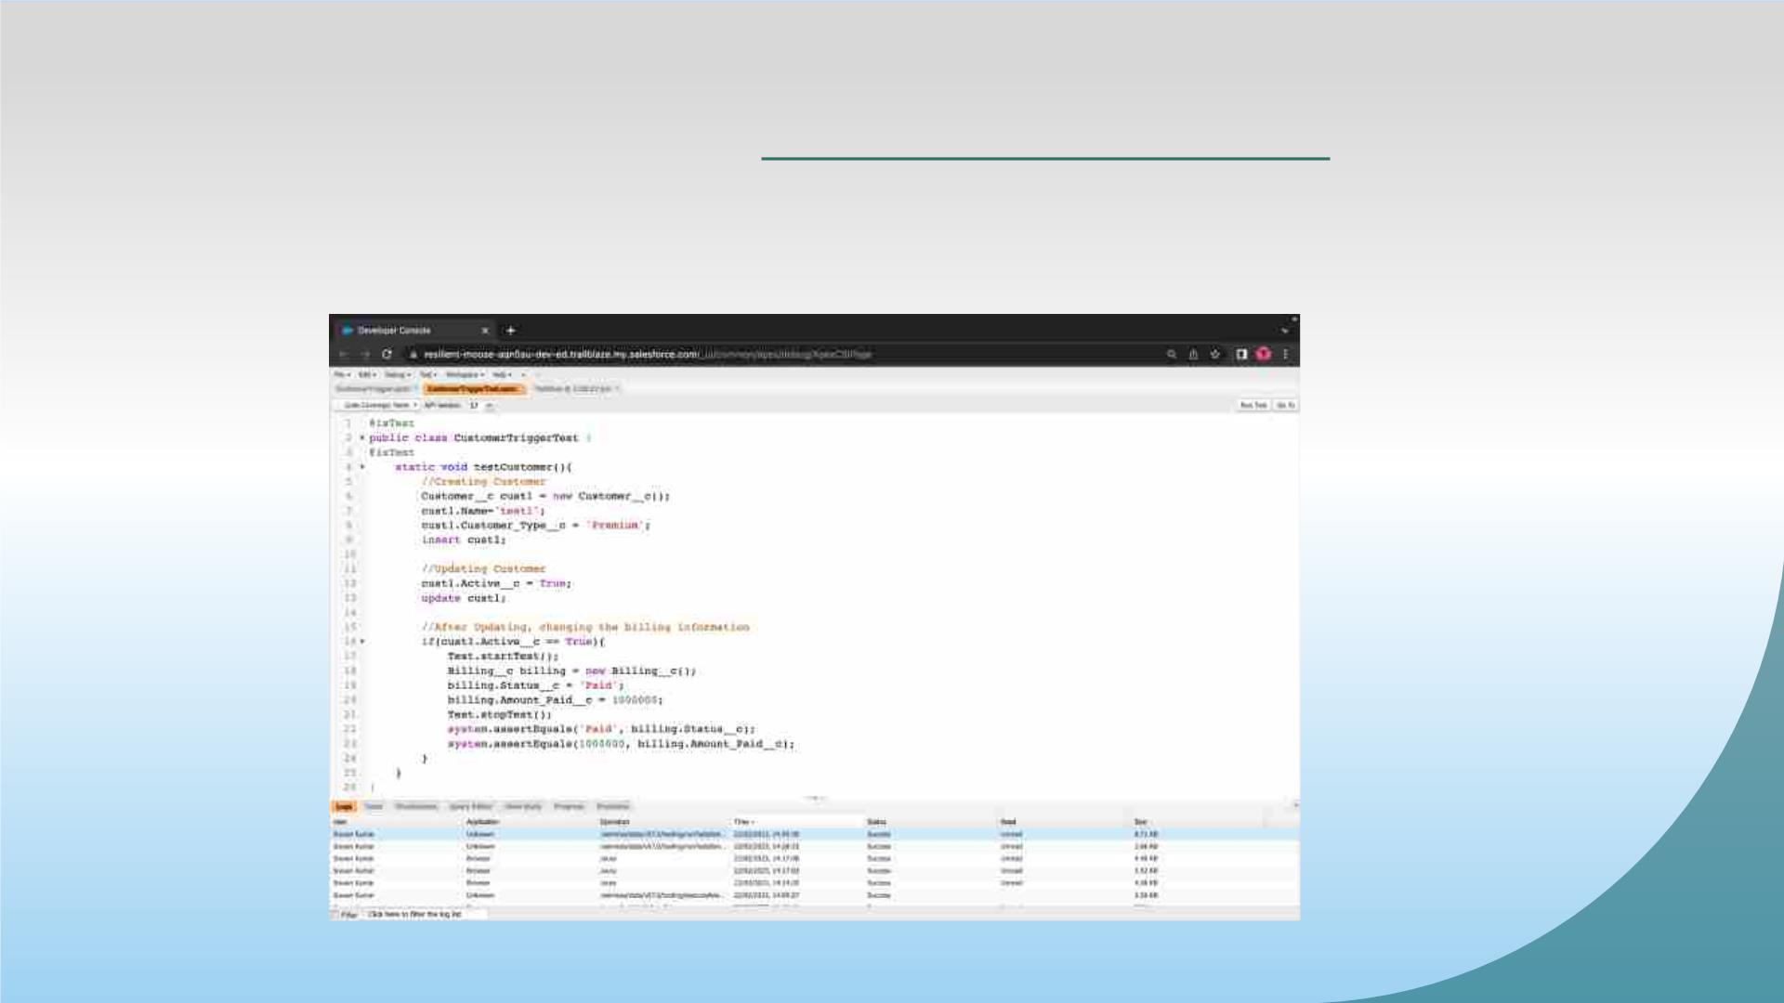
Exercise-13
Write a Test Class for CustomerTrigger.

Slide 43
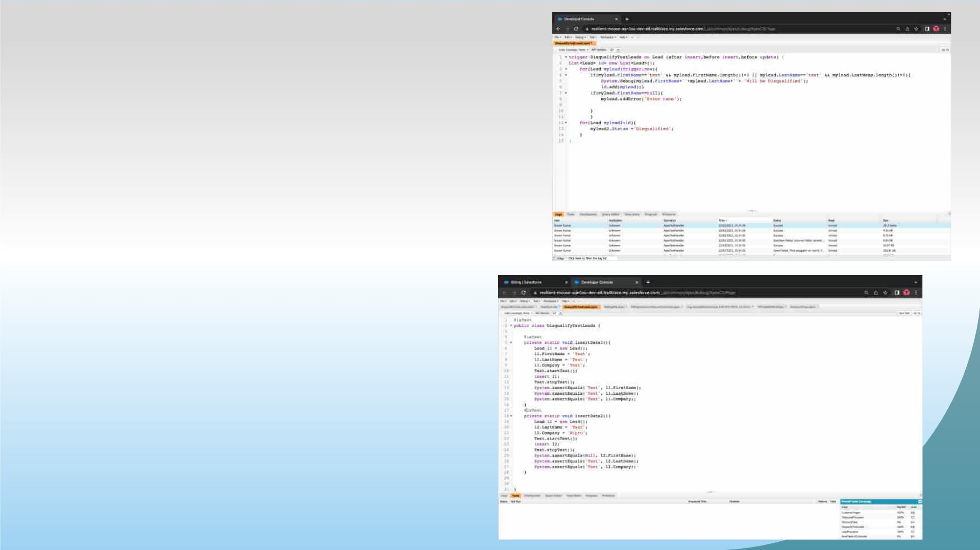
Exercise -14
ApexTrigger ,Name = DisqualifytestLeads
Exercise -15
Write a test class for Disqualifytestleads

Slide 44
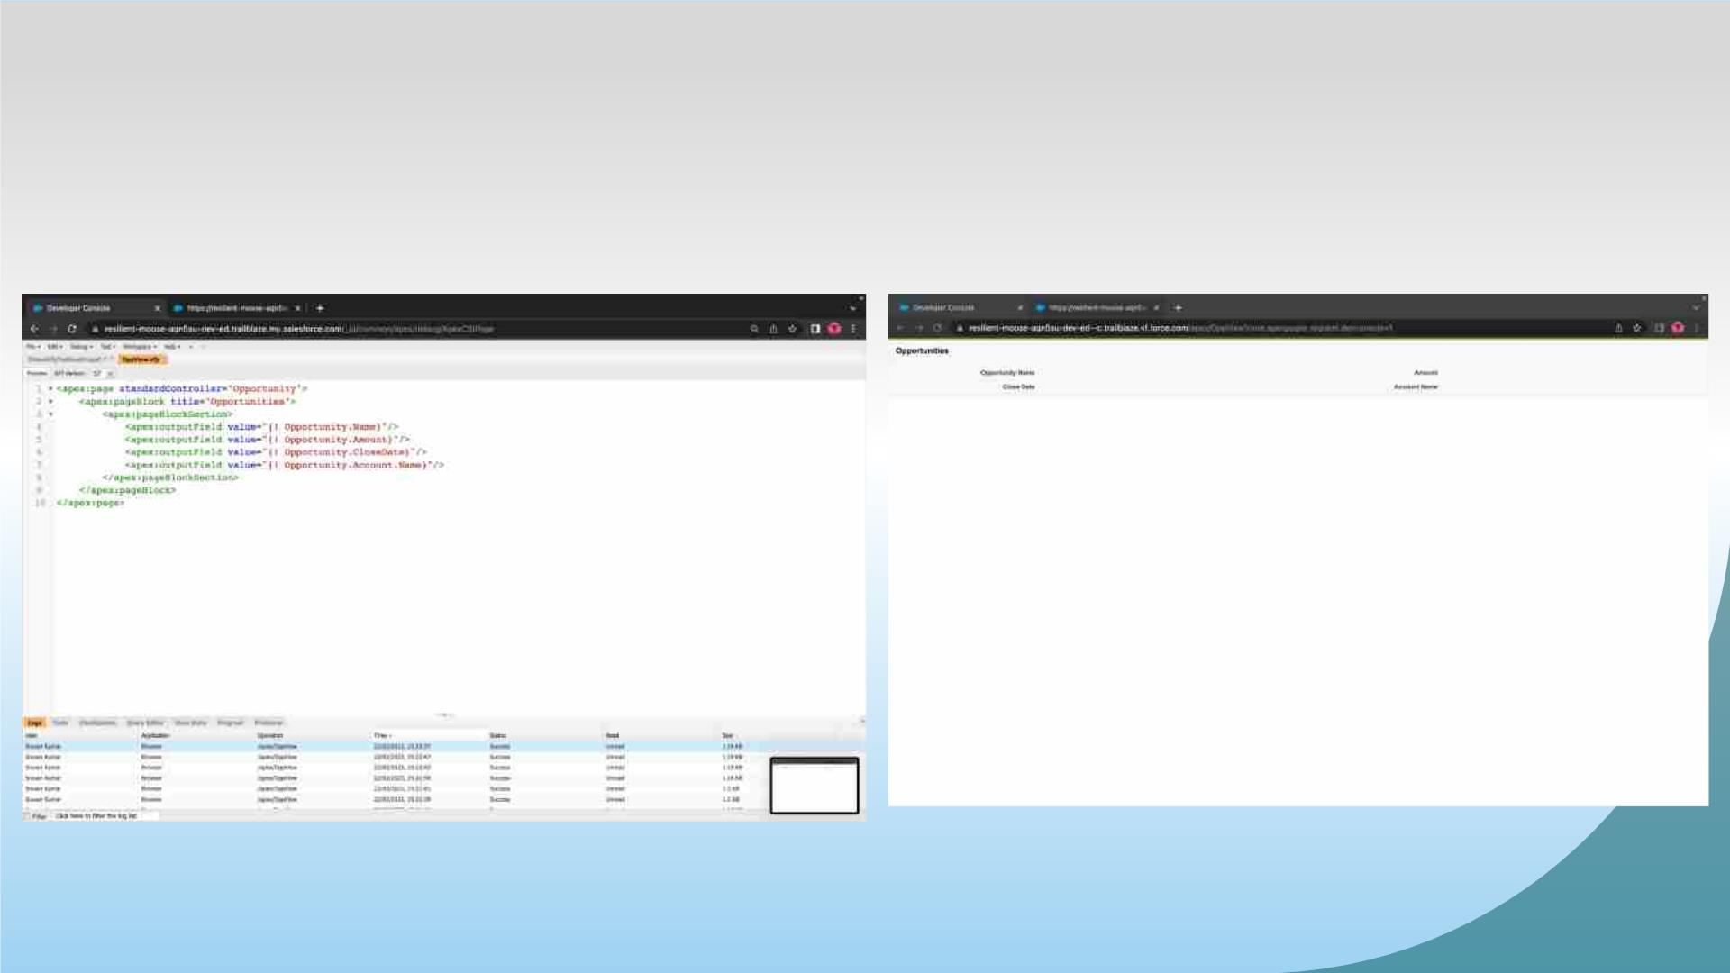
Exercise-16
Create a Visualforce page which displays Opportunity fields as
output fields.

Slide 45
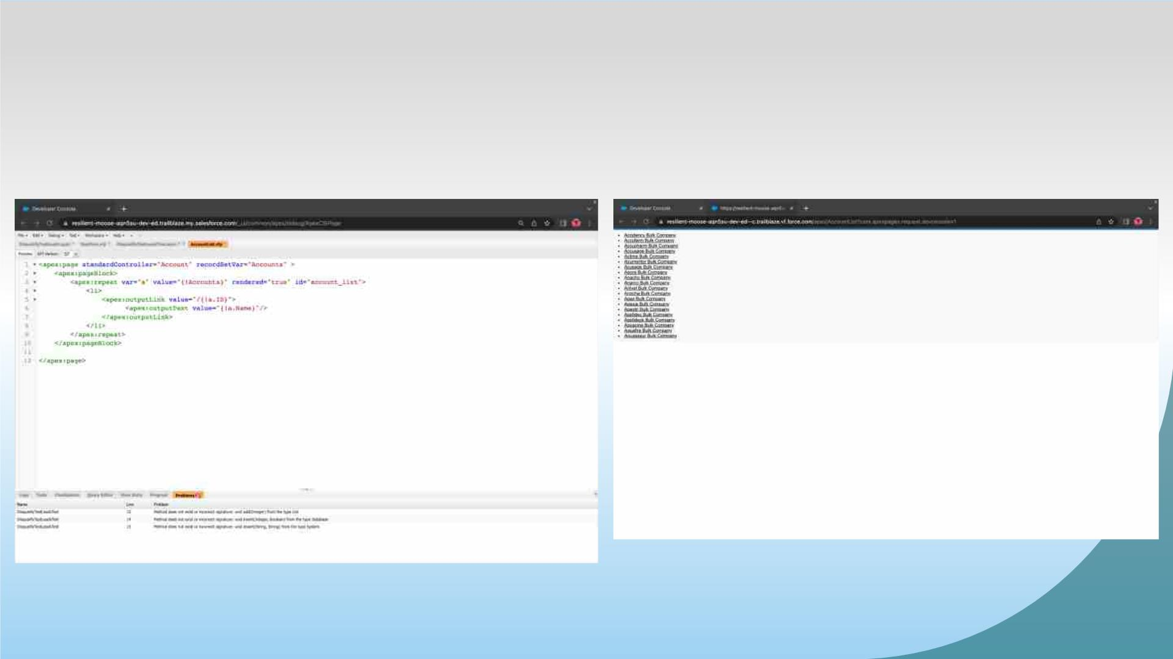
Exercise-17
Create a Visualforce page which shows a list of Accounts linked to
their record pages

Slide 46
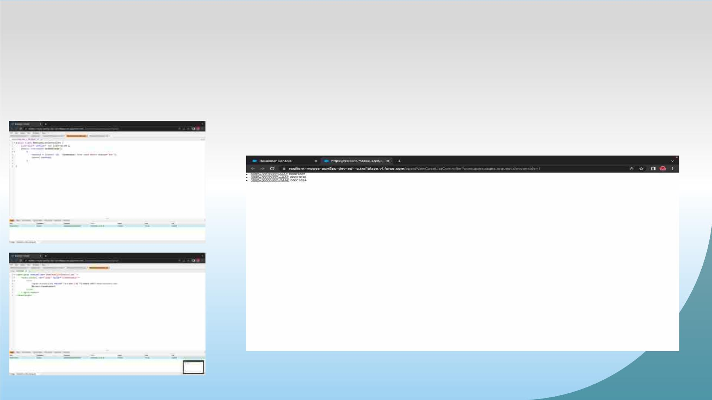
Exercise-18
Create a Visualforce page that uses a custom controller to display a
list of cases with the status of 'New'. The page must be named
NewCaseList.

Slide 47


